Slide 1
CSE-499(Final Defense) Presentation Slides
Supervised By:
Satyaki Das
Lecturer
University of Liberal Arts Bangladesh
Submitted By:
Name: Md. Meshkat
ID: 162014015
Computer Science And Engineering Dept.

Slide 2

Company Profile
MUNSHIELD Organization.
Address : House: #77, Road: #07,Mohammodpur, Dhaka-1207.
Contact Number : +88 0130 999 2053
Email : hr.admin@munshield.org
Website : https://munshield.org/

Slide 3
Working Period And Position
Designation : Junior Web Developer.
Working Period : 01 February 2020 to 05 May 2020
Time Frame for my project:
Month 1 | Month 2 | Month 3
15-20% | 45-50% | 30-35 %

Slide 4
The name of my web-development project is Food Lover.
So, What is Food Lover And what is Does?
“Food Lover is a platform where health concern people can find a Solution about their fitness problem in their busy life. In Our Daily life people are so busy that they can not maintain their balance diet. Here At Food Lover people’s health concern like weight gain, weight loss, Weight maintenance are our duty to give the proper fitness of our customer though proper nutrition and balance food.”

Slide 5



PREREQUIREMENTS
HTML
CSS
JavaScript
OOP
PHP
Frameworks : LARAVEL, Bootstrap

Slide 6




Tools that are used:
XAMPP
IDE (Sublime, Visual Studio code)
Composer
Web browser

Slide 7
The Objectives And The Challenges of the project :
Objectives:
Provide Website Platform for them.
Explore to extract the market demand.
Designing and developing the website.
Improving my soft skills
Challenges:
How to use and build Full Stack Website using popular framework (LARAVEL).
How to make Responsive Website.
Suggest new product ideas
Database connection ( Back-end Work).

Slide 8
A Short Description About The Framework
What is LARAVEL And why LARAVEL ?
LARAVEL is an open-source PHP framework designed to make developing web apps easier and faster through built-in features. It has A complete authentication system. A portable, virtual development environment and Object-relational mapping. I use LARAVEL because:
LARAVEL takes care of the security within its framework,
LARAVEL makes Authentication very simple.
It is fast and it has automated testing facilities.
Clean documentation and Model View Controller (MVC) support

Slide 9
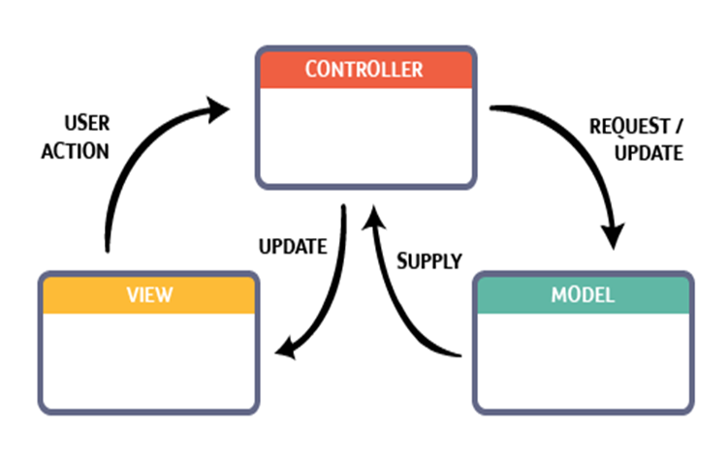
MVC Pattern Implementation in LARAVEL:
It separates the application into three parts: the model, the view, and the
controller. They Are shortly describe:
Models: A model is data used by a program. This may be a database,
file or a simple object. It is usually a class with properties that match
the columns in the database.
Views: A view is the means of displaying objects within an application.
Examples include displaying a window or buttons or text within a
window. It includes anything that the user can see. creating the projects
views. All the views are stored in the resources/views directory.
Controllers: A controller updates both models and views. It accepts input and performs the
corresponding update. a controller can update a model . By changing the attributes of a
character in a video game.

Slide 10
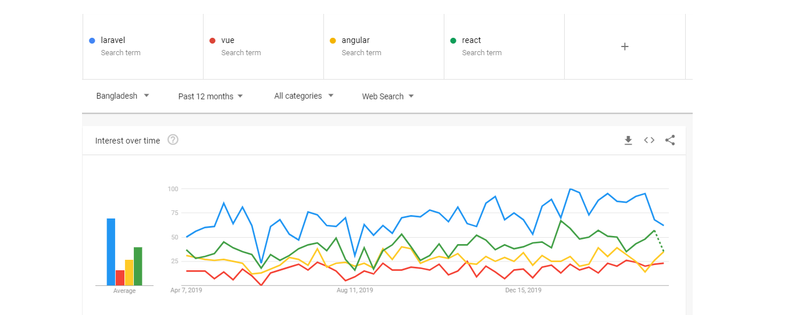
Comparison of LARAVEL
Figure-1: Compare of different framework in Bangladesh.

Slide 11
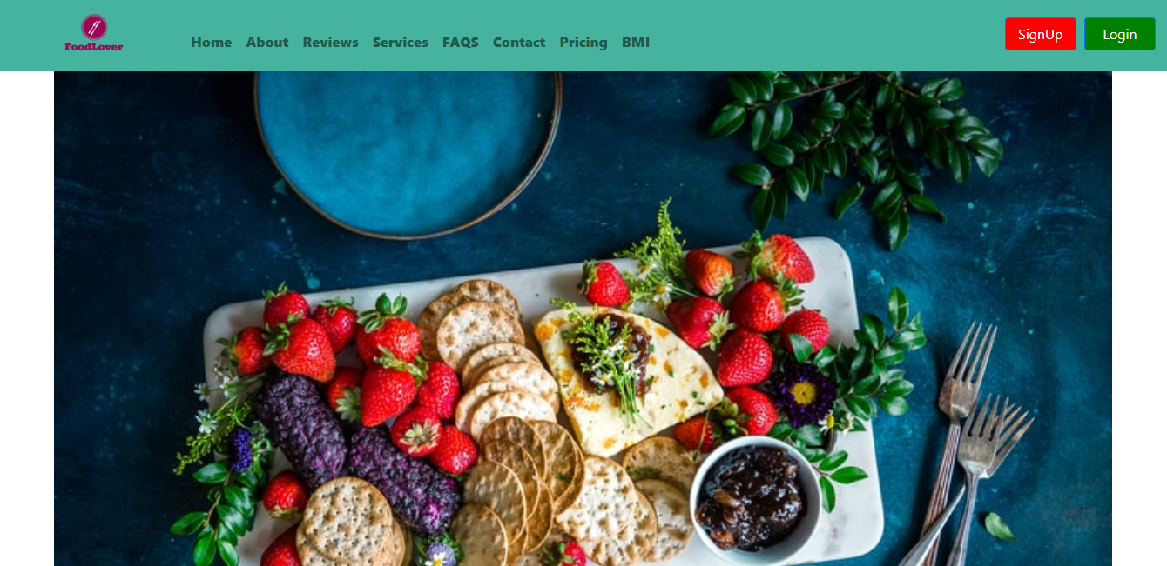
Implemented Work:
Figure-2: First Look designed for Food Lover.

Slide 12
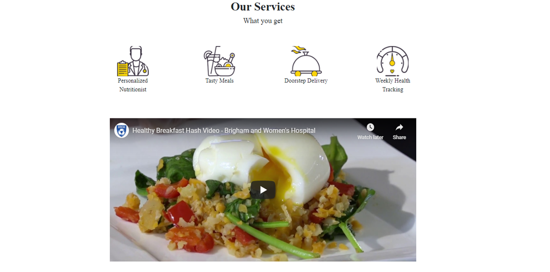
Implemented Work cont'd
Figure-3: Service section design for Food Lover.

Slide 13
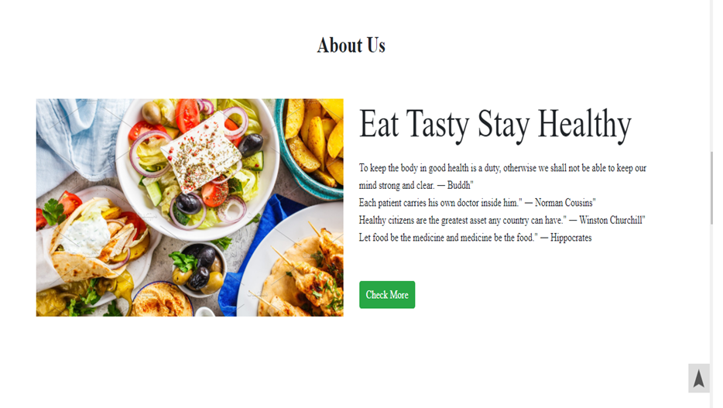
Implemented Work cont'd
Figure-4: About section design for Food Lover.

Slide 14
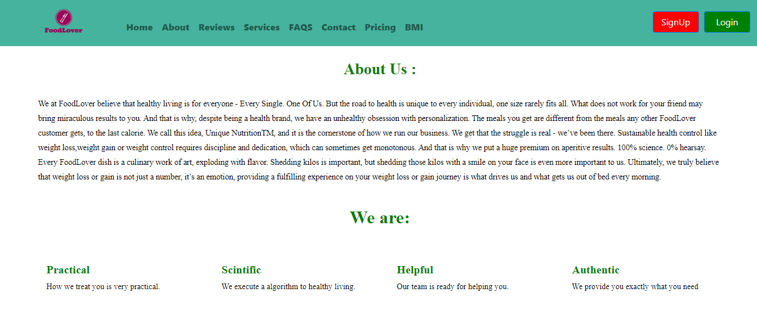
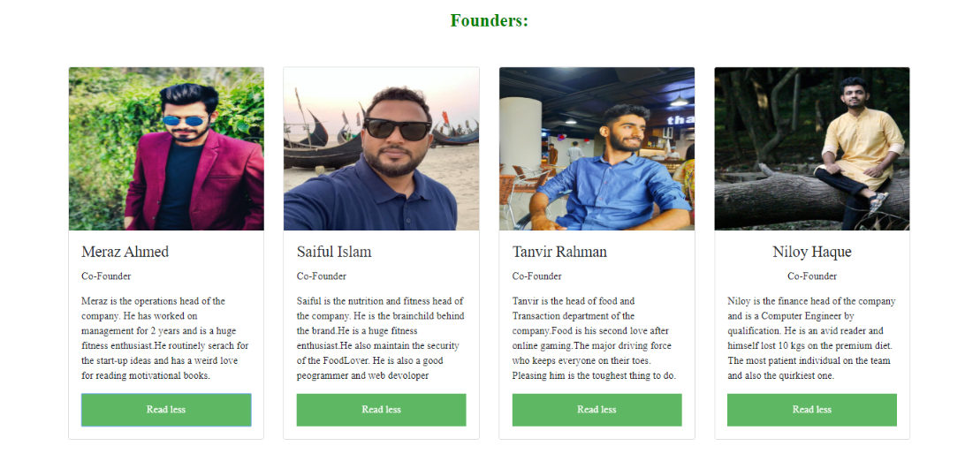
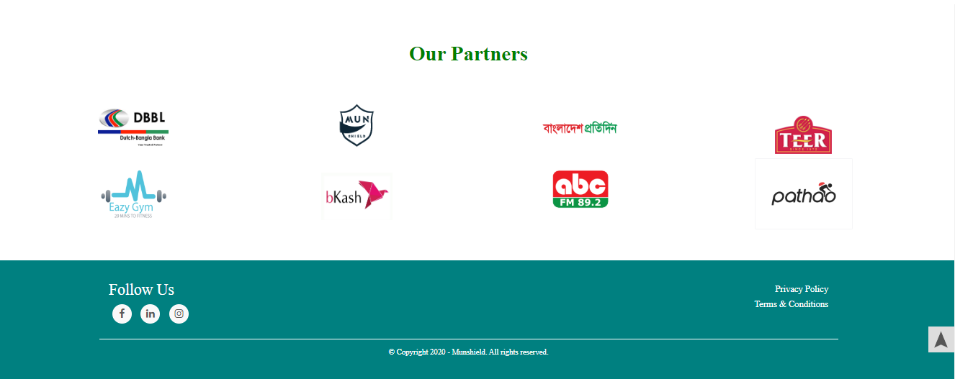
Figure-5: full view of about page.

Slide 15
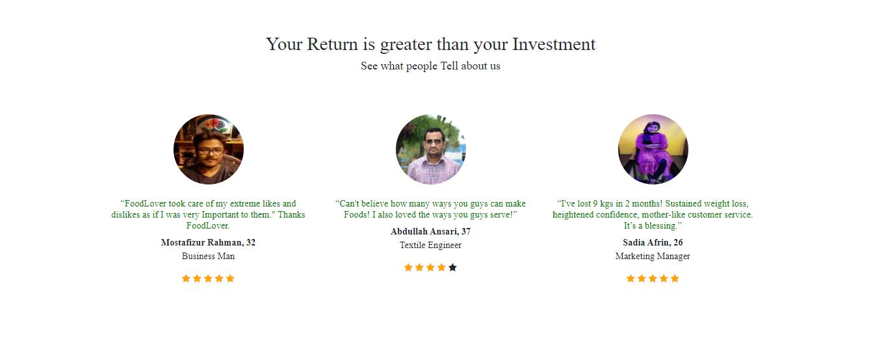
Implemented Work cont'd
Figure-6: Review section design for Food Lover

Slide 16
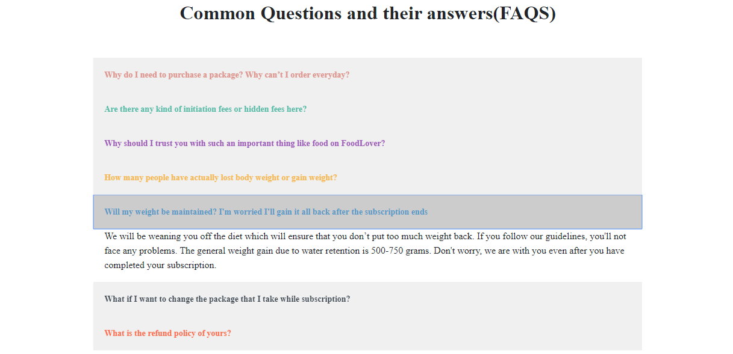
Implemented Work cont'd
Figure-7: FAQS section design for Food Lover.

Slide 17
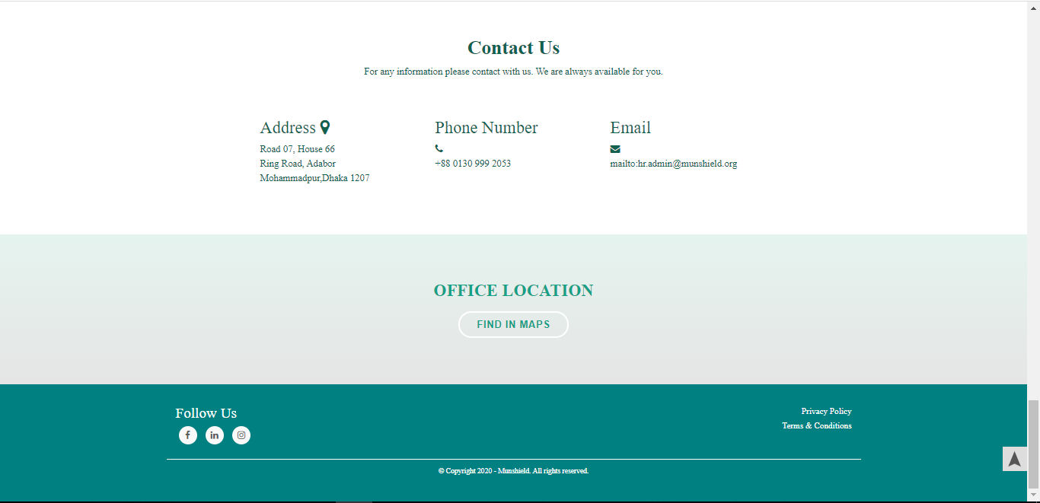
Implemented Work cont'd
Figure-8: Contact Us section design for Food Lover.

Slide 18
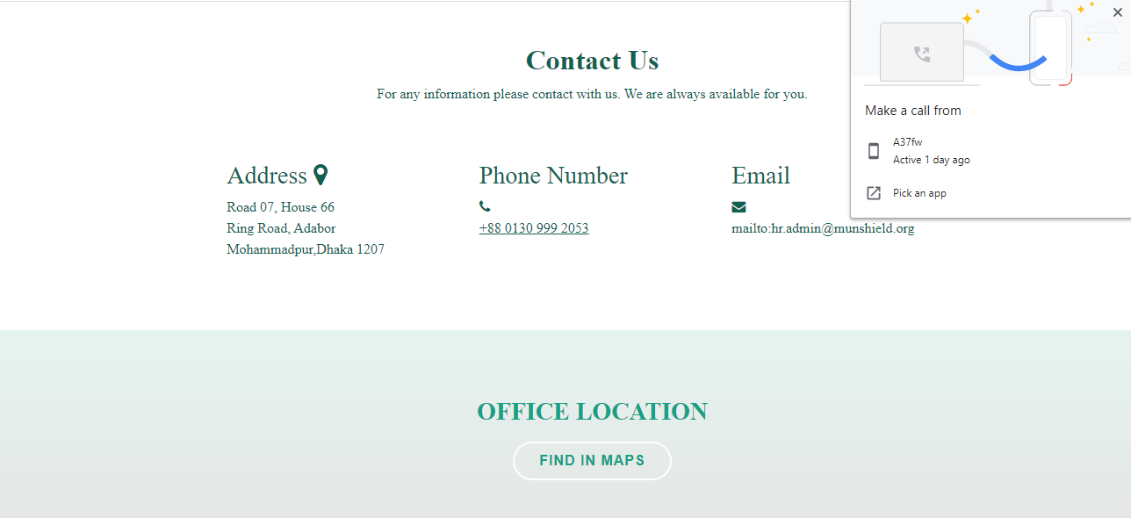
Implemented Work cont'd

Slide 19
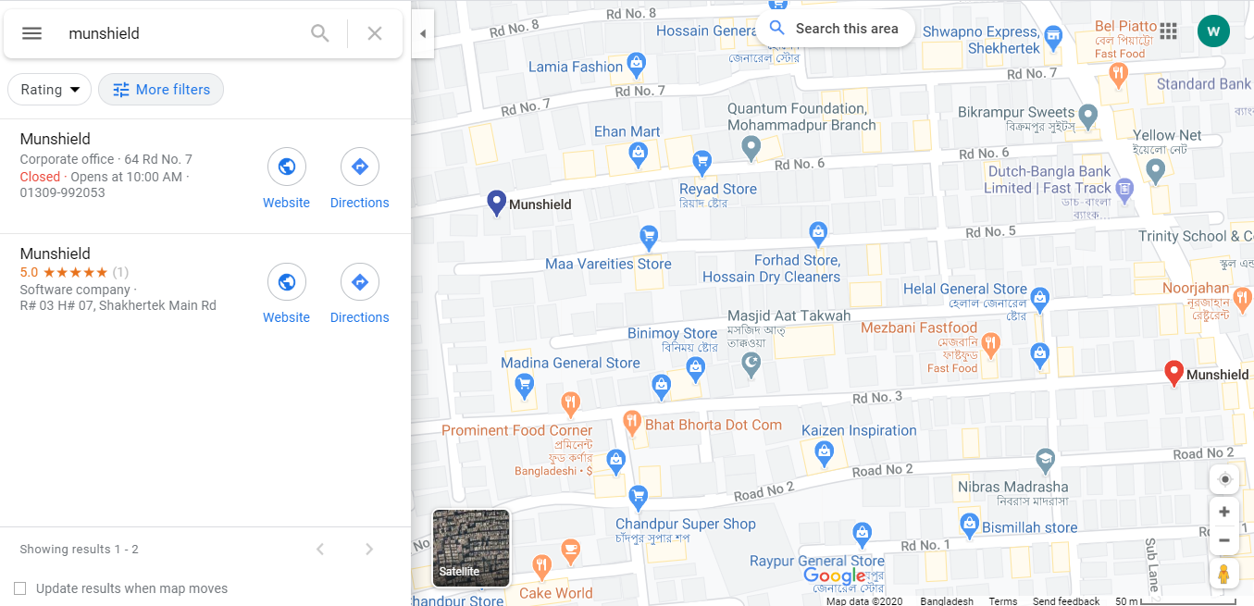
Find In Google Maps

Slide 20
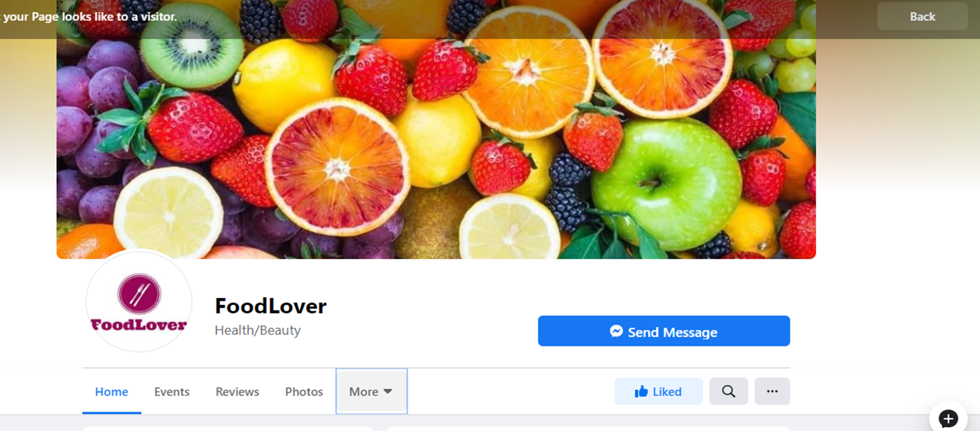
Social Media connection of Food Lover:
Figure-9: Social Media Connection of Food Lover.

Slide 21
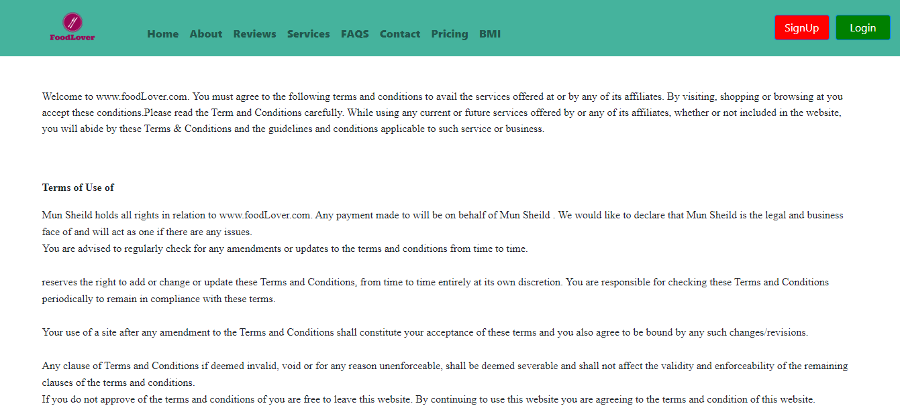
Implemented Work cont'd
Figure-10: Terms & Condition page designed for Food Lover.

Slide 22
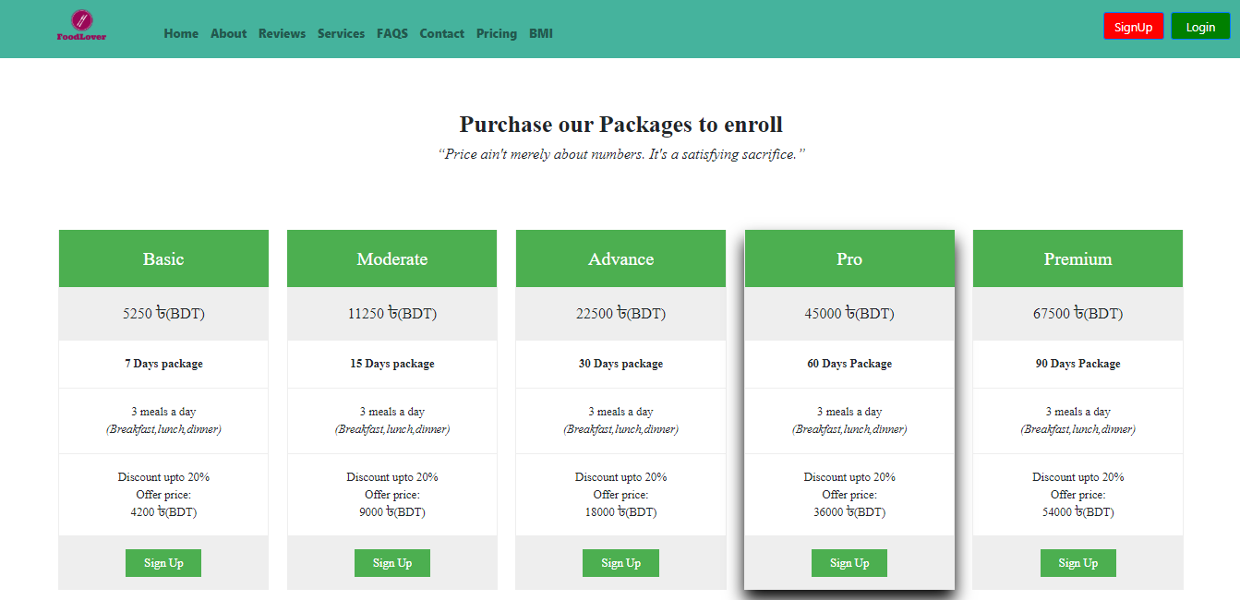
Implemented Work cont'd
Figure-11: Pricing page design for Food Lover.

Slide 23
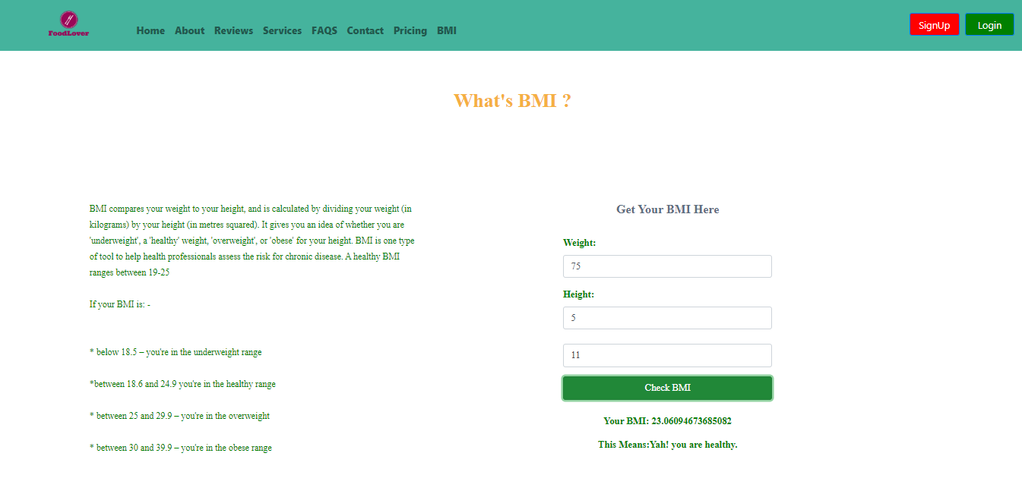
Implemented Work cont'd
Figure-12: BMI page design for Food Lover.

Slide 24
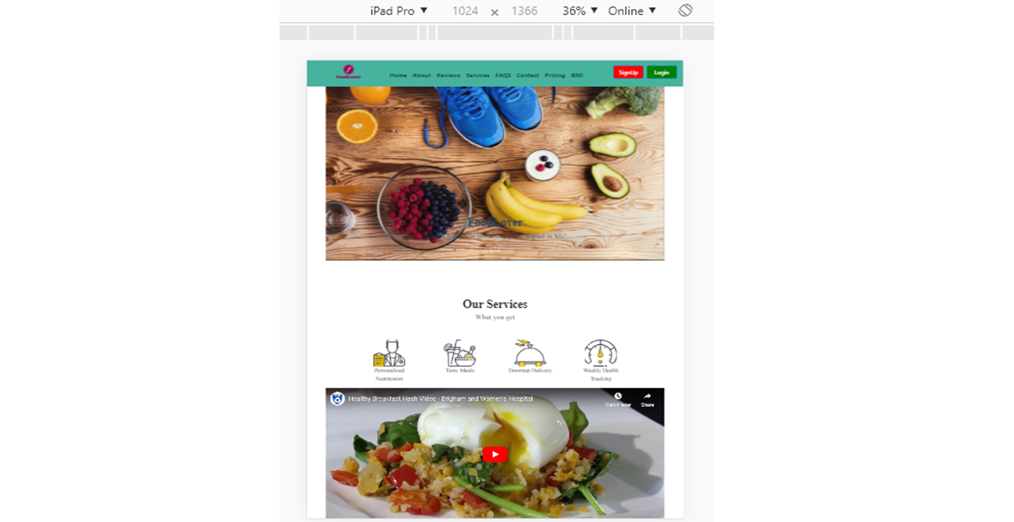
Figure-13: Responsive view of Food Lover.

Slide 25
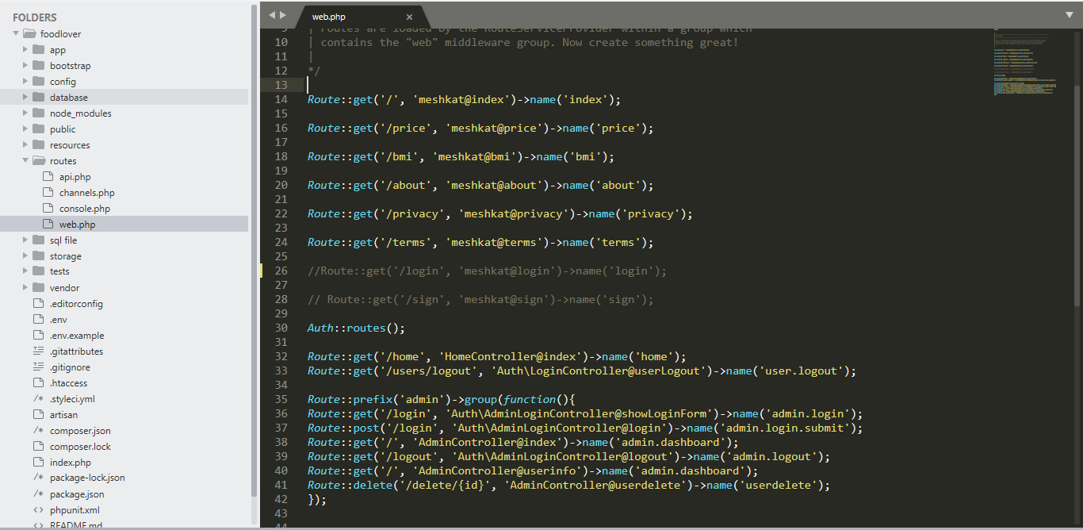
Figure-14: Route code of Food Lover.

Slide 26
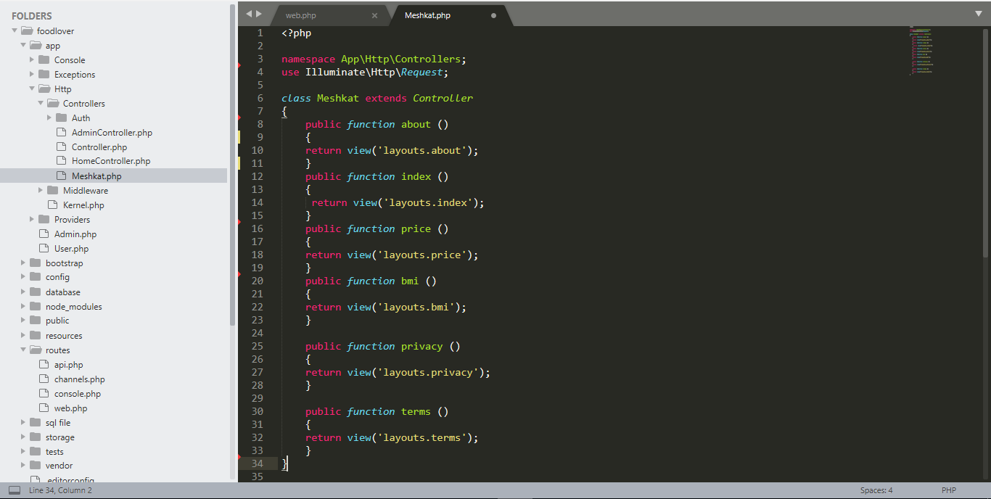
Figure-15: Controller code of Food Lover.

Slide 27
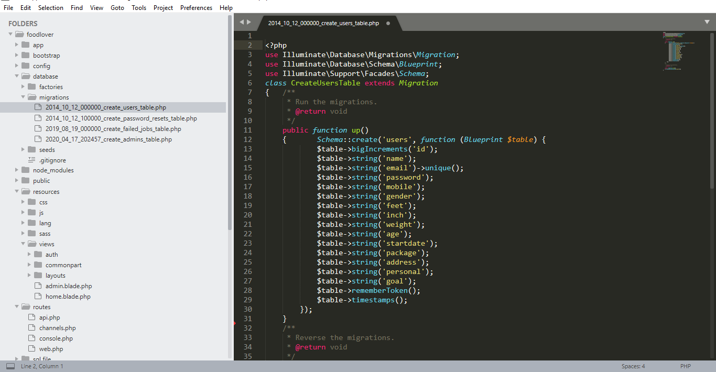
Figure-16: Creating model code of Food Lover.

Slide 28
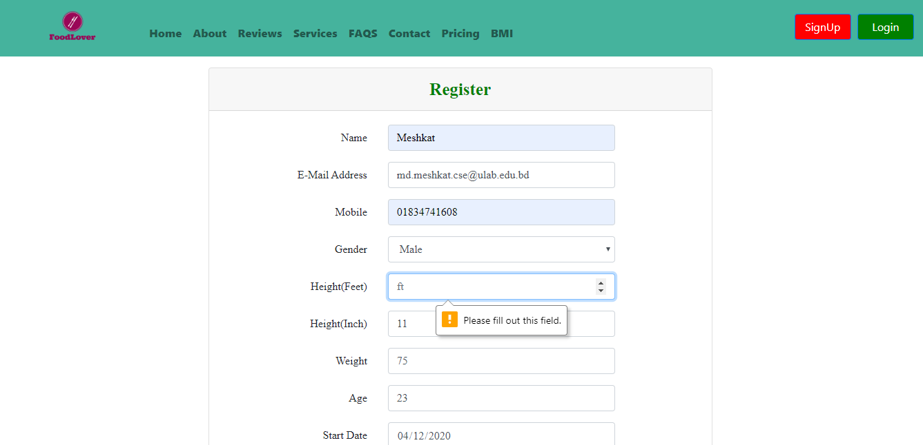
Implemented Work cont'd
Figure-17: Sign Up page design for Food Lover.

Slide 29
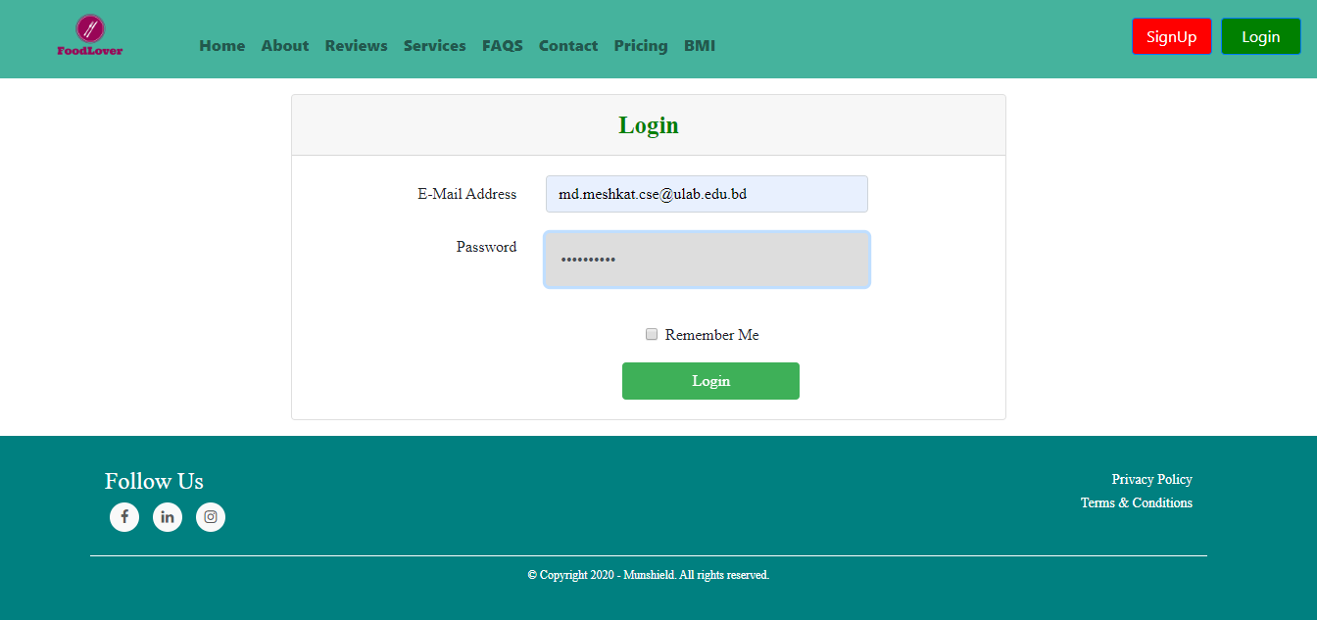
Implemented Work cont'd
Figure-18: Login page design for Food Lover.

Slide 30
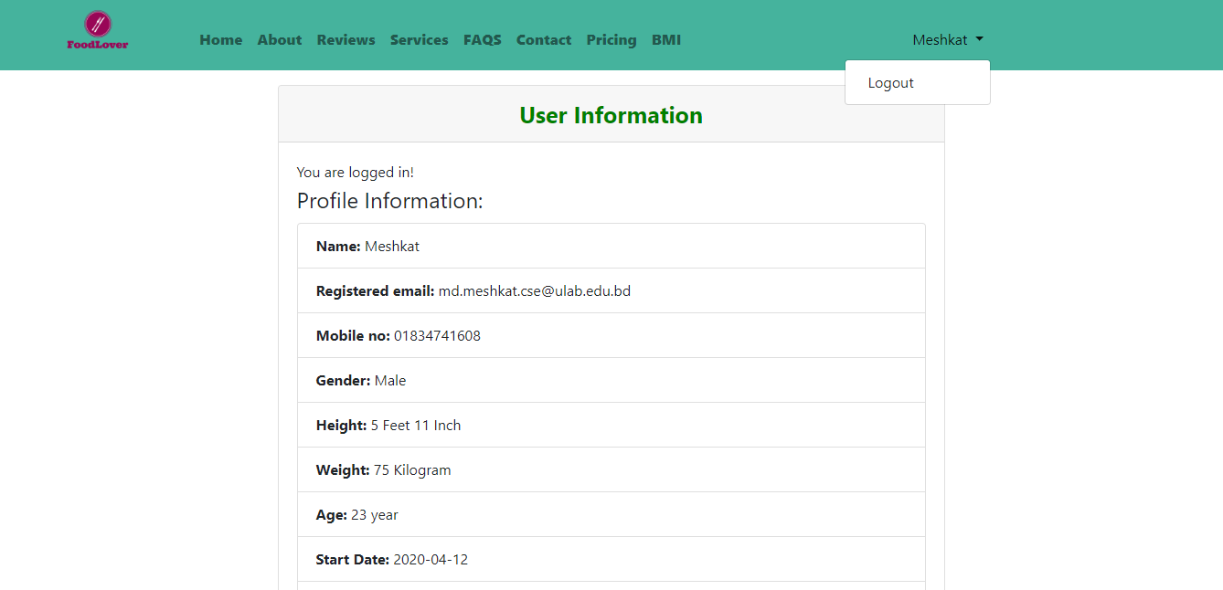
Implemented Work cont'd
Figure-19: User profile in Food Lover.

Slide 31
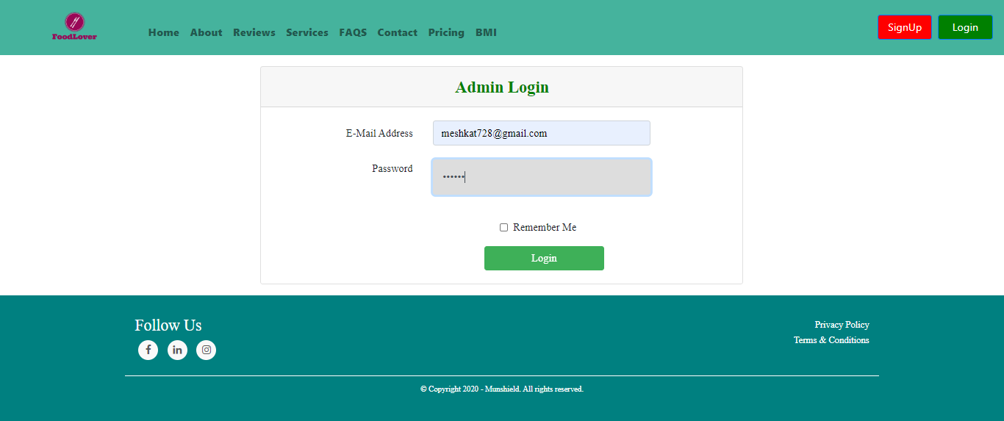
Implemented Work cont'd
Figure-20: Admin login in Food Lover.

Slide 32
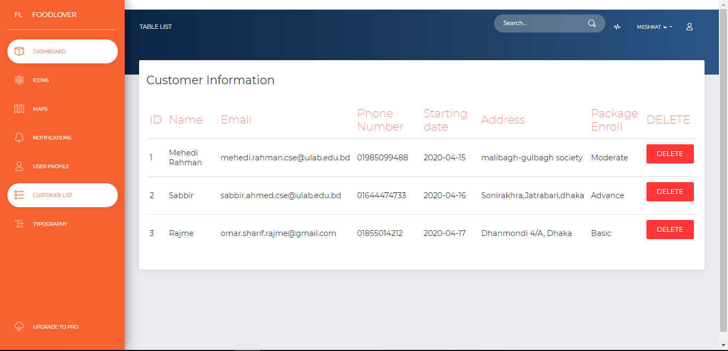
Implemented Work cont'd
Figure-21: Inside of admin panel in Food Lover

Slide 33
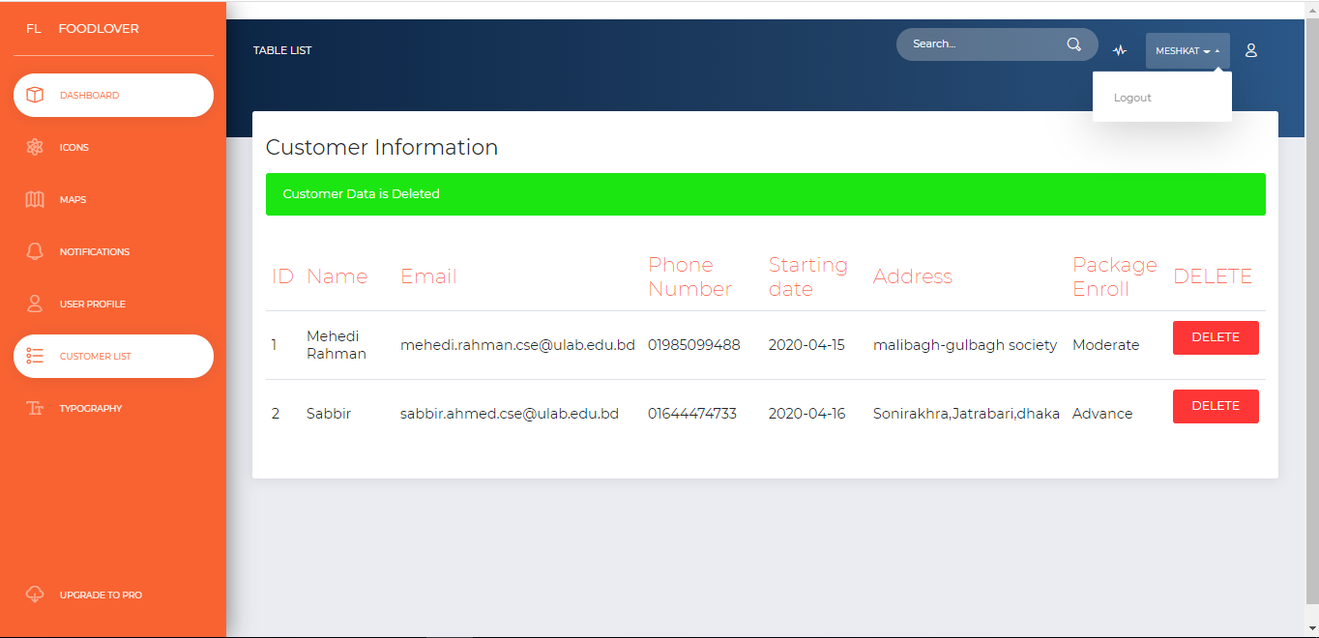
Implemented Work cont'd
Figure-22: Delete account in admin panel.

Slide 34
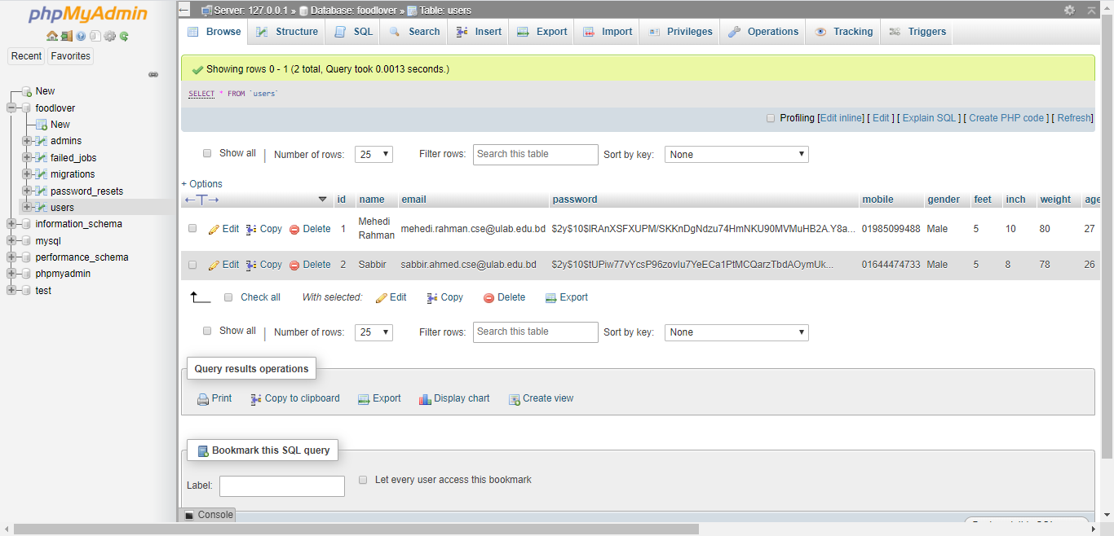
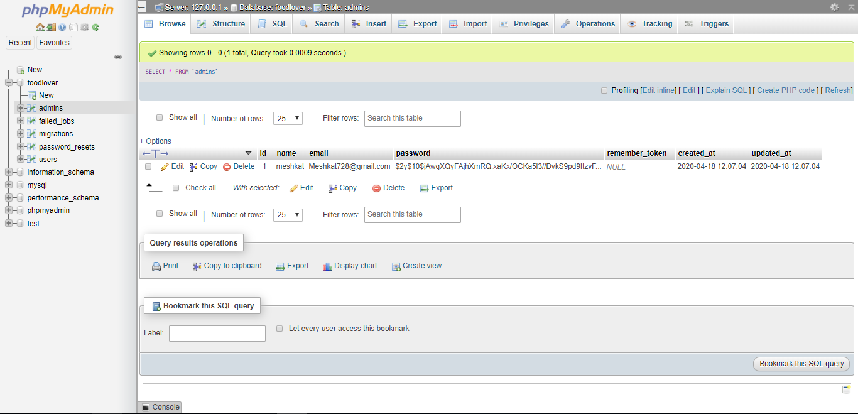
Implemented Work cont'd
Figure-23: Database Images of the Project.

Slide 35

Thank You

